Slide 1
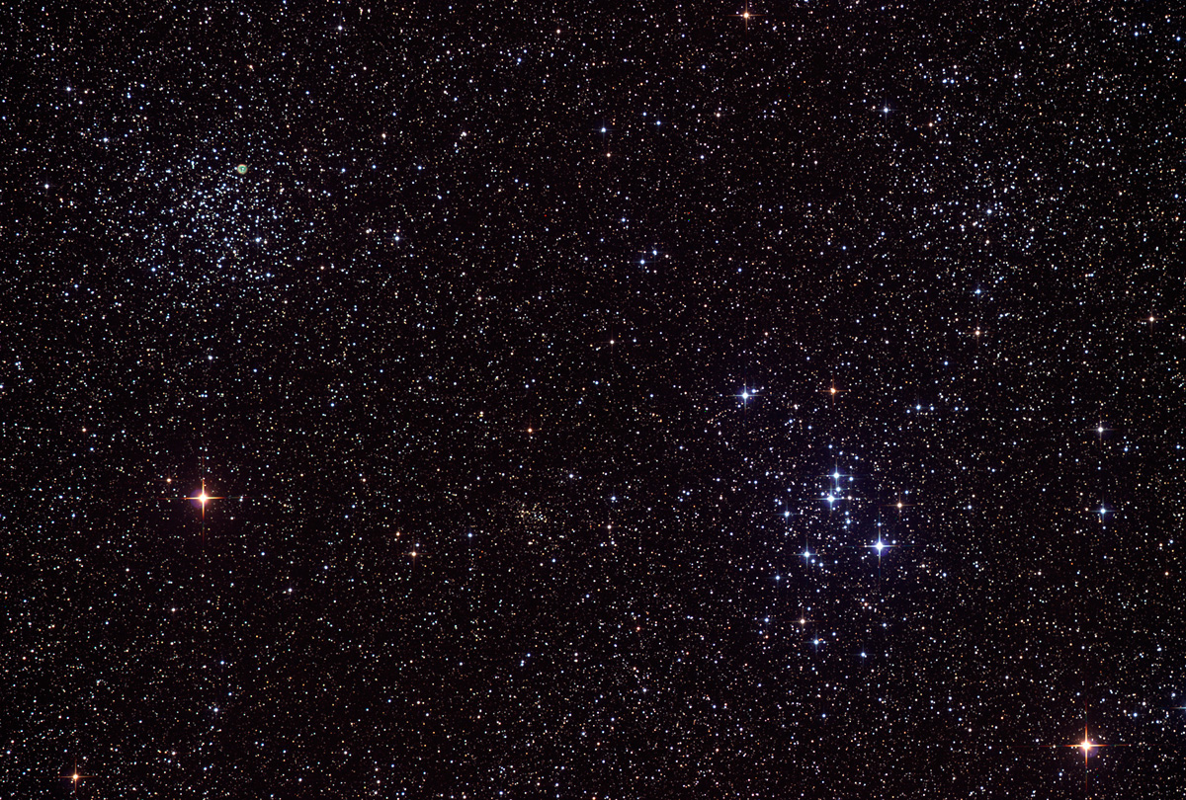

Astroschool:
Basic Image Processing Workflow
for one shot color images
14
June 19th, 2014
Notes:
Caveat: I only own, and have only ever used, PixInsight. I know squat about PhotoShop, so those of you that use PhotoShop will have to infer from my presentation what the appropriate tools are in PS.

Slide 2
Where did we leave off?
Image Calibration:
Correcting your raw images for dark current, BIAS signal, and uneven illumination
Then register your images and stack them. The result is a “master frame” for each channel/filter (or one color master frame).

Slide 3
What does a master frame look like?
Notes:
Not very interesting, because it is still in its linear format. Use this opportunity to talk about linear vs. non-linear data. Break out to PixInsight to show a histogram, and use the histogram to explain how dim our images are.

Slide 4
What can/should you do while your data is linear?
Screen Transfer Function (STF)
Crop
Gradient extraction
Background neutralization
Color calibration
Noise reduction
Deconvolution/sharpening
Histogram transformation (stretch to non-linear)

Slide 5
Stretching
Stretching is a process by which you change the black point and the mid point, so as to bring out the fine details in your image.
Notes:
Break out to PixInsight to do some stretching. Talk about what the histogram represents.

Slide 6
Non-linear processing
Steps you can/should take after stretching your data:
More noise reduction
HDR Wavelets
Color saturation
Bring out faint structures (several tools in PI)
More noise reduction
Green removal (SCNR)
Export for web

Slide 7
Image processing links
Ron Wodaski’s book:
http://www.newastro.com
Lessons from the Masters (Rob Gendler, ed.):
http://tinyurl.com/o6esqsk
Warren Keller’s tutorials:
http://www.ip4ap.com
Harry Page’s PI tutorials:
http://www.harrysastroshed.com/pixinsight/pixinsight%20video%20html/Pixinsighthome.html
JKMorse’s PixInsight cribsheet:
http://pixinsight.com/forum/index.php?topic=6823.msg46218#msg46218

